Slide 1


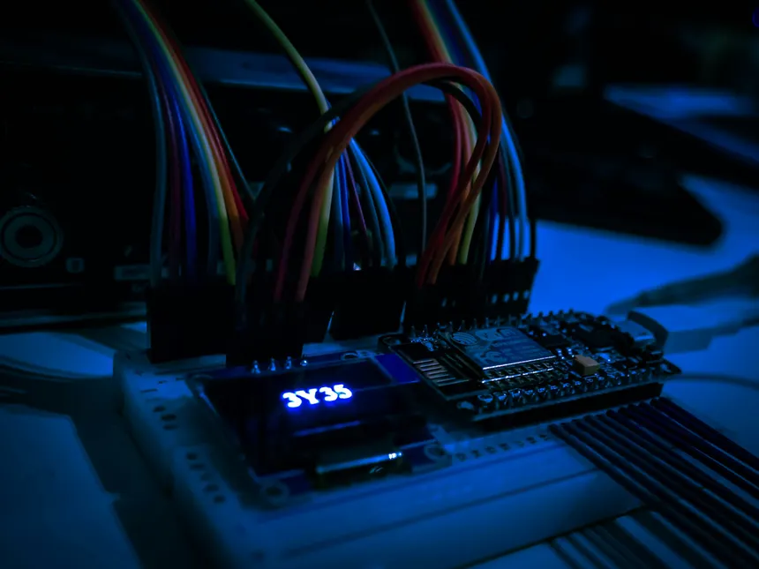
DCLab/Control System Crash Course
Microcontroller and Pulse-Width Modulation
An Introduction to Microcontroller and How they work
Session 01
DCLab/Control System Crash Course
>_ terminal gremlin (c-lydia ^_^)
Notes:
DIRECT EDIT VERSION: All visible artwork is on this slide. Click logos, labels, footer text, rules and panels directly. Text uses ordinary text boxes. Use the Selection Pane for small objects; items are named TEXT / LOGO / SHAPE. Duplicate a complete slide to reuse the design. New Slide layouts supply only basic placeholders. Background colour: Format Background / Slide Properties.
START HERE. Duplicate the slide you need to retain all editable elements. Replace bracketed text. Use the picture placeholder icon to insert your own photo; crop to fill or fit as needed. Click a logo directly to move, resize, delete or replace its picture. All logos are original unmodified artwork. Titles use Noto Sans Mono, body text Ubuntu Sans; install these or substitute your preferred fonts consistently. 16:9 format.

Slide 2
00 / Contents
Contents
01
Why Electronics?
How electronics and Control Systems are connected
02
Microcontroller
Microcontroller Architecture and Peripheral
03
PWM and LEDC
Basic of PWM and LED Control Peripheral
04
Implementation
Connecting the Theory to Physical System
DCLab/Control System Crash Course
>_ terminal gremlin (c-lydia ^_^)
Notes:
DIRECT EDIT VERSION: All visible artwork is on this slide. Click logos, labels, footer text, rules and panels directly. Text uses ordinary text boxes. Use the Selection Pane for small objects; items are named TEXT / LOGO / SHAPE. Duplicate a complete slide to reuse the design. New Slide layouts supply only basic placeholders. Background colour: Format Background / Slide Properties.
Use four actions with visible outcomes. Replace the verbs if your session has a different rhythm. Keep detail in speaker notes.

Slide 3
01 / Why Electronics?
>_
What would happen when we try to control an LED without actually understanding how electronics works?
Can motors behave like an LED? Not Exactly, but Both would cause Danger!!!
DCLab/Control System Crash Course
>_ terminal gremlin (c-lydia ^_^)
Notes:
DIRECT EDIT VERSION: All visible artwork is on this slide. Click logos, labels, footer text, rules and panels directly. Text uses ordinary text boxes. Use the Selection Pane for small objects; items are named TEXT / LOGO / SHAPE. Duplicate a complete slide to reuse the design. New Slide layouts supply only basic placeholders. Background colour: Format Background / Slide Properties.
Use the chapter title as a question. Pause for predictions. This dark transition is also useful before a live demo.

Slide 4
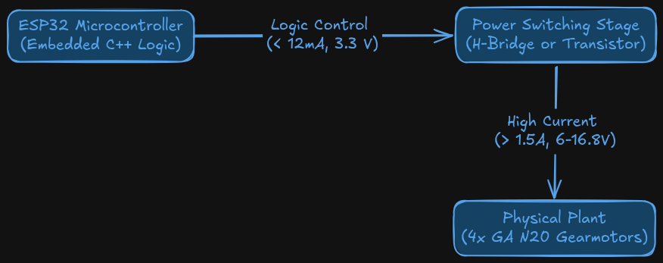
01 / Why Electronics?
The Current and Voltage Gap
What Could Go wrong?
> Electrical Destruction
Thermal Overcurrent
Inductive Kickback
Do NOT connect the load directly to a microcontroller pins
DCLab/Control System Crash Course
>_ terminal gremlin (c-lydia ^_^)
Notes:
DIRECT EDIT VERSION: All visible artwork is on this slide. Click logos, labels, footer text, rules and panels directly. Text uses ordinary text boxes. Use the Selection Pane for small objects; items are named TEXT / LOGO / SHAPE. Duplicate a complete slide to reuse the design. New Slide layouts supply only basic placeholders. Background colour: Format Background / Slide Properties.
Use the photo or diagram as the evidence. The left column should explain how to read it. Picture space is approximately 16:9. Keep the source in the caption or notes.

Slide 5
01 / Why Electronics
Logic Level Domains and Signal Translation
3.3V
CMOS Logic Domain
ESP32 GPIO Pins Input
5V
TTL Domain
Sensors and Legacy Peripheral
6V
Motor Drive
Isolated and Regulated Motor Driver Rail
14.8+V
Battery Pack
Energy Storage for all Components
DCLab/Control System Crash Course
>_ terminal gremlin (c-lydia ^_^)
Notes:
DIRECT EDIT VERSION: All visible artwork is on this slide. Click logos, labels, footer text, rules and panels directly. Text uses ordinary text boxes. Use the Selection Pane for small objects; items are named TEXT / LOGO / SHAPE. Duplicate a complete slide to reuse the design. New Slide layouts supply only basic placeholders. Background colour: Format Background / Slide Properties.
Use four actions with visible outcomes. Replace the verbs if your session has a different rhythm. Keep detail in speaker notes.

Slide 6
01 / Why Electronics?
Grounding, Return Paths, and Decoupling
Grounding
Constraints
When 2 subsystems exchange logical signals, they must share a ground reference.
Without it the signal defined as 3.3 V by the transmitter has an undefined, floating voltage potential at the receiver.
Ground loop Interference
  High-frequency ground bounce and inductive noise are introduced by motor
Separation Rule
  Motor path requires short paths, heavy ground wire (AWG 18 or 20), and terminated directly at power supply or screw terminal star ground
Decoupling Capacitors
  Needs capacitors (ceramic and electrolytic) to smooth high-frequency noise and buffer transient supply dips
Dclab/Control System crash Course
>_ terminal gremlin (c-lydia ^_^)
Notes:
DIRECT EDIT VERSION: All visible artwork is on this slide. Click logos, labels, footer text, rules and panels directly. Text uses ordinary text boxes. Use the Selection Pane for small objects; items are named TEXT / LOGO / SHAPE. Duplicate a complete slide to reuse the design. New Slide layouts supply only basic placeholders. Background colour: Format Background / Slide Properties.
Two independent picture placeholders. Use identical crops/scales for comparisons. Suitable for oscilloscope captures, wiring changes or debug output.

Slide 7
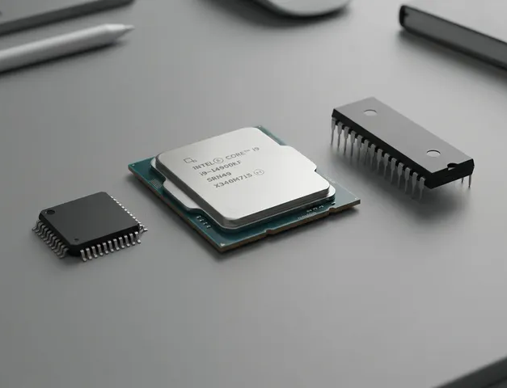
02 / Microcontroller
CPU, MPU, and MCU
01
Central Processing Unit (CPU)
The ALU and instruction execution pipeline
02
Microprocessor (MPU)
A high-performance processor, running heavy computation but lacks deterministic, hard real-time pin timing
03
Microntroller (MCU)
A self-contained SoC integrating CPU with high-speed generation and dedicated hardware peripheral, providing deterministic real-time control
DCLab/Control System Crash Course
>_ terminal gremlin (c-lydia ^_^)
Notes:
DIRECT EDIT VERSION: All visible artwork is on this slide. Click logos, labels, footer text, rules and panels directly. Text uses ordinary text boxes. Use the Selection Pane for small objects; items are named TEXT / LOGO / SHAPE. Duplicate a complete slide to reuse the design. New Slide layouts supply only basic placeholders. Background colour: Format Background / Slide Properties.
Insert a photo. Move the three numbered markers onto the relevant hardware features. They are ordinary editable shapes, separate from the picture placeholder. Use one clear connection per callout. Validate actual wiring against your hardware documentation.

Slide 8
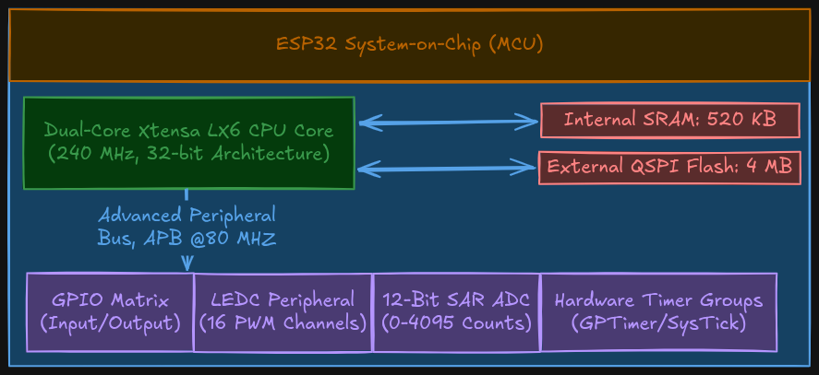
02 / Microcontroller
ESP32 Architecture
DCLab/Control System Crash Coourse
>_ terminal gremlin (c-lydia ^_^)
Notes:
DIRECT EDIT VERSION: All visible artwork is on this slide. Click logos, labels, footer text, rules and panels directly. Text uses ordinary text boxes. Use the Selection Pane for small objects; items are named TEXT / LOGO / SHAPE. Duplicate a complete slide to reuse the design. New Slide layouts supply only basic placeholders. Background colour: Format Background / Slide Properties.
Best for circuit diagrams, timing plots, architecture exports and screenshots. Use Fit rather than Fill when cropping would hide labels. Prefer the editable architecture layout when creating a new diagram.

Slide 9
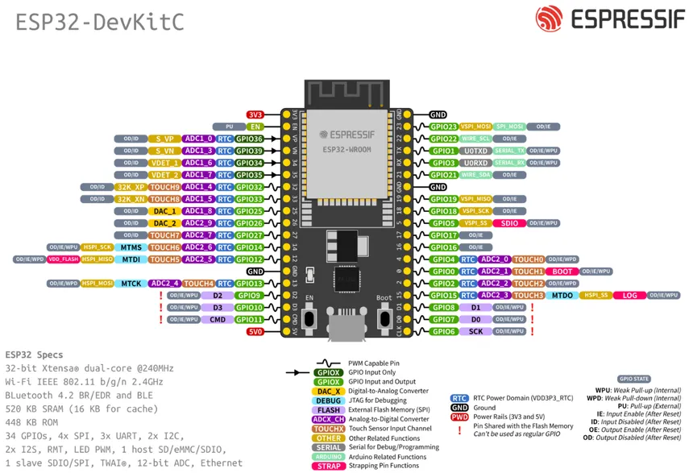
02 / Microcontroller
GPIO Matrix
01
GPIO 0-33
Standard bidirectional pins with fully configurable features
02
Input-Only
Lacks internal output driver and pullup or pulldown resistors
03
Boot Strapping
Determine boot mode
DCLab/Control System Crash Coourse
>_ terminal gremlin (c-lydia ^_^)
Notes:
DIRECT EDIT VERSION: All visible artwork is on this slide. Click logos, labels, footer text, rules and panels directly. Text uses ordinary text boxes. Use the Selection Pane for small objects; items are named TEXT / LOGO / SHAPE. Duplicate a complete slide to reuse the design. New Slide layouts supply only basic placeholders. Background colour: Format Background / Slide Properties.
Best for circuit diagrams, timing plots, architecture exports and screenshots. Use Fit rather than Fill when cropping would hide labels. Prefer the editable architecture layout when creating a new diagram.

Slide 10
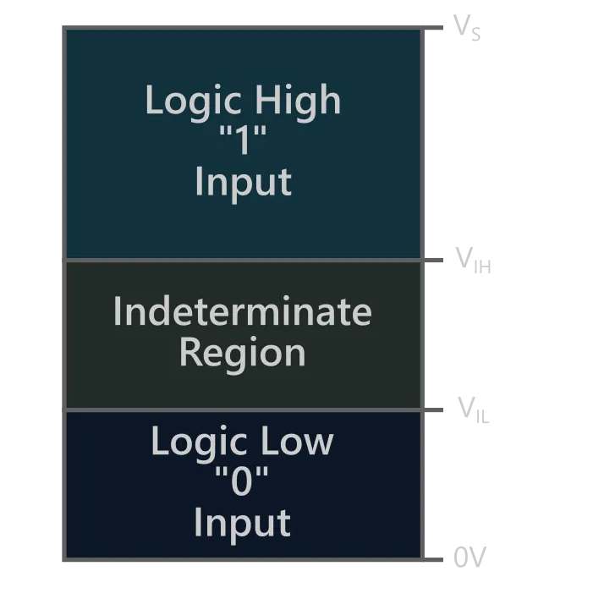
02 / Microcontroller
Floating Inputs
Floating Inputs
Pull Resistors
An input pins without pull resistors can have high-input impedance state which causes electromagnetic radiation couples capacitively into the pin gate, so the logic level oscillate unpredictably
Input pullup
  Connects internal resistors to HIGH
  pin defaults to logic HIGH
  Ground pulls the pin to logic Low when active (active low)
Input pulldown
  Connects internal resistor to LOW
  Pin defaults to LOW
  When active, the pin is HIGH (active high)
Dclab/Control System crash Course
>_ terminal gremlin (c-lydia ^_^)
Notes:
DIRECT EDIT VERSION: All visible artwork is on this slide. Click logos, labels, footer text, rules and panels directly. Text uses ordinary text boxes. Use the Selection Pane for small objects; items are named TEXT / LOGO / SHAPE. Duplicate a complete slide to reuse the design. New Slide layouts supply only basic placeholders. Background colour: Format Background / Slide Properties.
Two independent picture placeholders. Use identical crops/scales for comparisons. Suitable for oscilloscope captures, wiring changes or debug output.

Slide 11
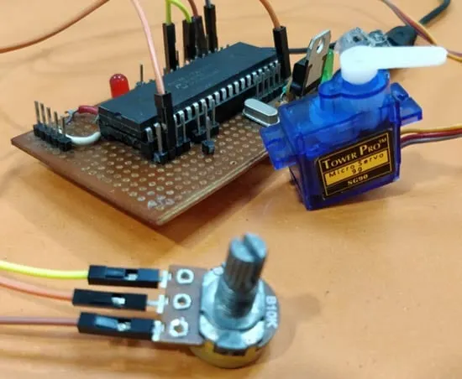
03 / Pulse-Width Modulation and LEDC
What is Pulse-Width Modulation?
A Method for controlling analog power delivery to motors and actuators using binary digital outputs
How?
By rapidly toggle a pin between LOW and HIGH at a constant carrier frequency
DCLab/Control System Crash Course
>_ terminal gremlin (c-lydia ^_^)
Notes:
DIRECT EDIT VERSION: All visible artwork is on this slide. Click logos, labels, footer text, rules and panels directly. Text uses ordinary text boxes. Use the Selection Pane for small objects; items are named TEXT / LOGO / SHAPE. Duplicate a complete slide to reuse the design. New Slide layouts supply only basic placeholders. Background colour: Format Background / Slide Properties.
Duplicate this slide for an answer reveal. Keep the answer in speaker notes on the question slide. Replace the figure with a small trace, code excerpt or image; use a code layout for longer snippets.

Slide 12
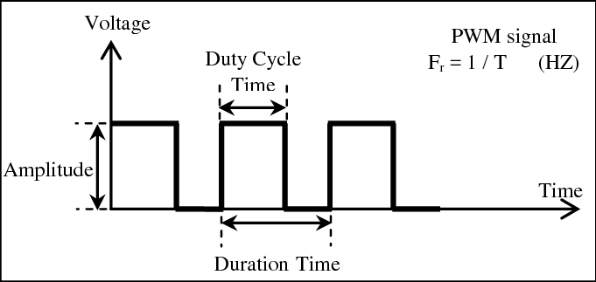
03 / Pulse-Wdith Modulation and LEDC
PWM Waveform
DCLab/Control System Crash Coourse
>_ terminal gremlin (c-lydia ^_^)
Notes:
DIRECT EDIT VERSION: All visible artwork is on this slide. Click logos, labels, footer text, rules and panels directly. Text uses ordinary text boxes. Use the Selection Pane for small objects; items are named TEXT / LOGO / SHAPE. Duplicate a complete slide to reuse the design. New Slide layouts supply only basic placeholders. Background colour: Format Background / Slide Properties.
Best for circuit diagrams, timing plots, architecture exports and screenshots. Use Fit rather than Fill when cropping would hide labels. Prefer the editable architecture layout when creating a new diagram.

Slide 13
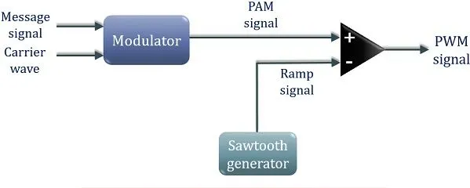
03 / Pulse-Width modulation and LEDC
PWM Carrier Period and Carrier Frequency
Carrier Period: the duration of one complete waveform cycle
Carrier Frequency: the pulse repetition rate per second
DCLab/Control System Crash Course
>_ terminal gremlin (c-lydia ^_^)
Notes:
DIRECT EDIT VERSION: All visible artwork is on this slide. Click logos, labels, footer text, rules and panels directly. Text uses ordinary text boxes. Use the Selection Pane for small objects; items are named TEXT / LOGO / SHAPE. Duplicate a complete slide to reuse the design. New Slide layouts supply only basic placeholders. Background colour: Format Background / Slide Properties.
Simple equation is editable text. For fractions, matrices and advanced notation, replace it with Insert > Equation in PowerPoint or Insert > Object > Formula in LibreOffice. Keep variable definitions and units visible.

Slide 14
03 / Pulse-Width modulation and LEDC
Duty Cycle and Time-Averaged DC Voltage
Duty Cycle: the fractional ratio of active HIGH duration relative to total period
Time-Averaged DC Voltage: the mathematical definite integral over one complete cycle
DCLab/Control System Crash Course
>_ terminal gremlin (c-lydia ^_^)
Notes:
DIRECT EDIT VERSION: All visible artwork is on this slide. Click logos, labels, footer text, rules and panels directly. Text uses ordinary text boxes. Use the Selection Pane for small objects; items are named TEXT / LOGO / SHAPE. Duplicate a complete slide to reuse the design. New Slide layouts supply only basic placeholders. Background colour: Format Background / Slide Properties.
Simple equation is editable text. For fractions, matrices and advanced notation, replace it with Insert > Equation in PowerPoint or Insert > Object > Formula in LibreOffice. Keep variable definitions and units visible.

Slide 15
03 / Pulse-Width Modulation and LEDC
LEDC Hardware Peripheral
Hardware Architecture
Internal Analog Filter
16 independent PWM channels grouped into 2 high-speed or low-speed blocks, driven by 4 internal hardware timer modules
When connected to a multimeter, the internal ADC acts as a continuous low-pass filter with integration windows between 100-300 ms
Clock Source
Driven by APB clock; the peripheral operates autonomously via direct memory-mapped registers, consuming zero CPU cycles
Resolution
Sets the integer quantization range of the duty cycle; maximum achievable PWM frequency is constrained by the timer clock and bit resolution
Dclab/Control System crash Course
>_ terminal gremlin (c-lydia ^_^)
Notes:
DIRECT EDIT VERSION: All visible artwork is on this slide. Click logos, labels, footer text, rules and panels directly. Text uses ordinary text boxes. Use the Selection Pane for small objects; items are named TEXT / LOGO / SHAPE. Duplicate a complete slide to reuse the design. New Slide layouts supply only basic placeholders. Background colour: Format Background / Slide Properties.
Two independent picture placeholders. Use identical crops/scales for comparisons. Suitable for oscilloscope captures, wiring changes or debug output.

Slide 16
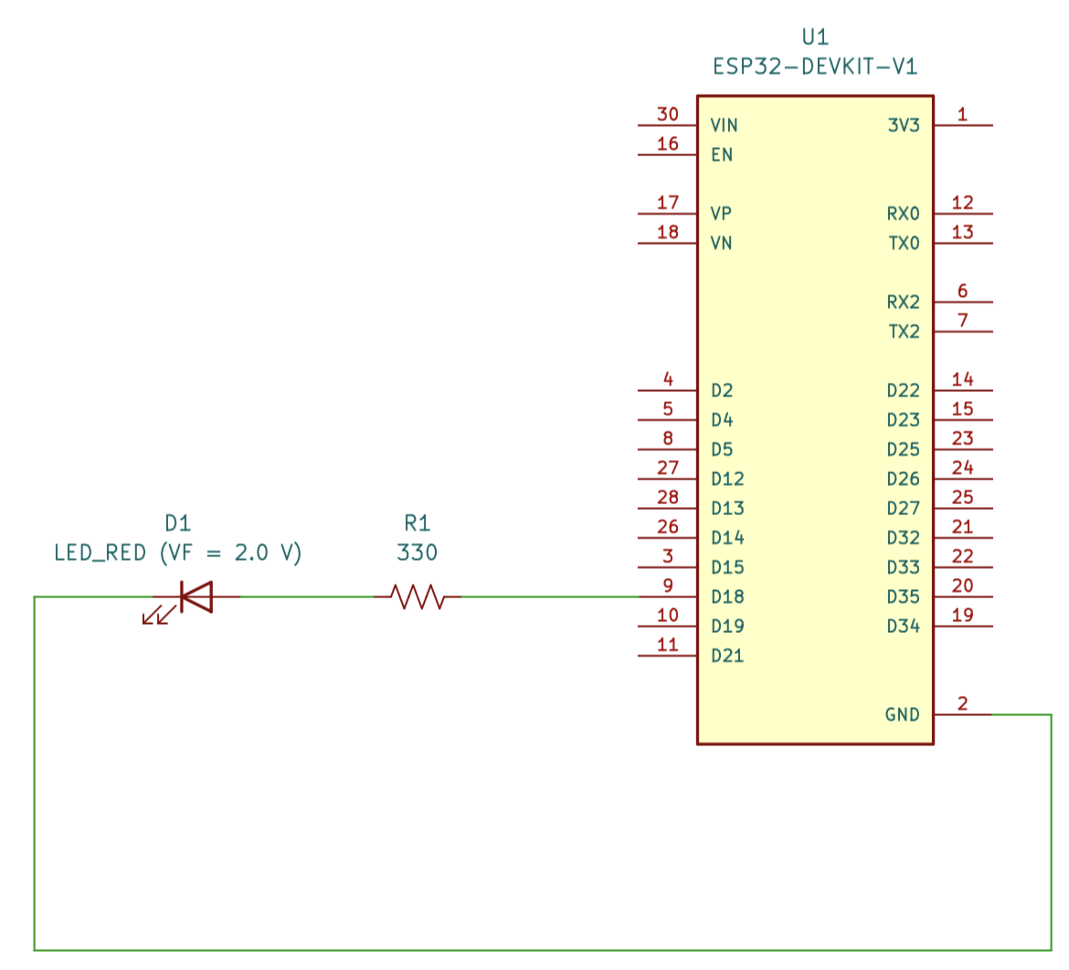
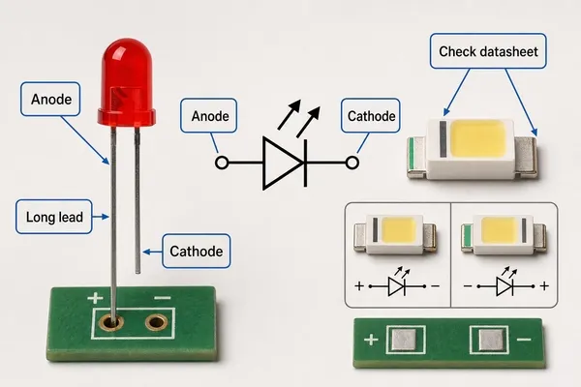
04 / Implementation
How to wire components
DCLab/Control System Crash Coourse
>_ terminal gremlin (c-lydia ^_^)
Notes:
DIRECT EDIT VERSION: All visible artwork is on this slide. Click logos, labels, footer text, rules and panels directly. Text uses ordinary text boxes. Use the Selection Pane for small objects; items are named TEXT / LOGO / SHAPE. Duplicate a complete slide to reuse the design. New Slide layouts supply only basic placeholders. Background colour: Format Background / Slide Properties.
Best for circuit diagrams, timing plots, architecture exports and screenshots. Use Fit rather than Fill when cropping would hide labels. Prefer the editable architecture layout when creating a new diagram.

Slide 17
04 / Implementation
How to use Multimeter
Continuity Mode
Resistance Mode
DC Voltage Mode
Keep the power
disconnected
Keep the power disconnected
Connect to power
Verify 0 Ohm continuity
along GND
Verify passive component values
Verify LDO regulator and buck converter rail
Confirm zero short-circuit between VCC and GND
Verify DC motor armature coil winding resistance
Probe PWM output pin to verify voltage scaling
DCLab/Control System Course
>_ terminal gremlin (c-lydia ^_^)
Notes:
DIRECT EDIT VERSION: All visible artwork is on this slide. Click logos, labels, footer text, rules and panels directly. Text uses ordinary text boxes. Use the Selection Pane for small objects; items are named TEXT / LOGO / SHAPE. Duplicate a complete slide to reuse the design. New Slide layouts supply only basic placeholders. Background colour: Format Background / Slide Properties.
Use three real failure modes. Make each test concrete: where to probe, what to print or which variable to inspect. Keep corrective actions in speaker notes until the evidence supports them.

Slide 18
04 / Implementation
Pre-Power Test
01
Continuity Mode
Confirm that audible beep is working by touching the red and black probes together
02
Power Check
Check metal USB shield and the GND rail; confirm they are shorted
03
Resistance Mode
Measure between the 3V3 pin and GND; if the reading is below 10 Ohms, do NOT connect to power
Do NOT plugin the USB cable until you completed these tests
DCLab/Control System Crash Course
>_ terminal gremlin (c-lydia ^_^)
Notes:
DIRECT EDIT VERSION: All visible artwork is on this slide. Click logos, labels, footer text, rules and panels directly. Text uses ordinary text boxes. Use the Selection Pane for small objects; items are named TEXT / LOGO / SHAPE. Duplicate a complete slide to reuse the design. New Slide layouts supply only basic placeholders. Background colour: Format Background / Slide Properties.
End with actionable statements, not a list of section titles. The next experiment should reuse the same tools and change one variable.

Slide 19
04 / Implementation / Firmware 01 of 04
Firmware: Configure PWM
const uint8_t PWM_OUTPUT_PIN = 18; // GPIO connected to the LED or driver input
const uint32_t PWM_FREQUENCY = 20000; // 20 kHz ultrasonic PWM carrier
const uint8_t PWM_RESOLUTION = 8; // 8-bit duty resolution: 0-255 counts
const uint8_t LEDC_CHANNEL = 0; // Hardware LEDC channel index
GPIO 18 | 20 kHz carrier | 8-bit duty | LEDC channel 0
DCLab/Control System Crash Course
>_ terminal gremlin (c-lydia ^_^)
Notes:
Source: Microcontroller (MCU) and Pulse-Width Modulation (PWM).pdf, pp. 10–12.
Selected lines are verbatim: no identifiers, functions, expressions, or indentation have been changed.
Global configuration excerpt. The full PDF also declares RAMP_INTERVAL_MS = 20, current_duty_count = 0, and ramp_direction = 1.
const uint8_t PWM_OUTPUT_PIN = 18; // GPIO connected to the LED or driver input
const uint32_t PWM_FREQUENCY = 20000; // 20 kHz ultrasonic PWM carrier
const uint8_t PWM_RESOLUTION = 8; // 8-bit duty resolution: 0-255 counts
const uint8_t LEDC_CHANNEL = 0; // Hardware LEDC channel index

Slide 20
04 / Implementation / Firmware 02 of 04
Firmware: Initialize and Write
bool initHardwarePWM() {
return ledcAttachChannel(
PWM_OUTPUT_PIN,
PWM_FREQUENCY,
PWM_RESOLUTION,
LEDC_CHANNEL
);
}
void setHardwarePWM(uint8_t duty_count) {
ledcWrite(PWM_OUTPUT_PIN, duty_count);
}
Initialize once in setup(); write a new duty value through setHardwarePWM().
DCLab/Control System Crash Course
>_ terminal gremlin (c-lydia ^_^)
Notes:
Source: Microcontroller (MCU) and Pulse-Width Modulation (PWM).pdf, pp. 10–12.
Selected lines are verbatim: no identifiers, functions, expressions, or indentation have been changed.
Two verbatim function excerpts. The comment between the two functions is omitted; their bodies are unchanged. The full setup() checks initHardwarePWM() for failure and starts with setHardwarePWM(0).
bool initHardwarePWM() {
return ledcAttachChannel(
PWM_OUTPUT_PIN,
PWM_FREQUENCY,
PWM_RESOLUTION,
LEDC_CHANNEL
);
}
void setHardwarePWM(uint8_t duty_count) {
ledcWrite(PWM_OUTPUT_PIN, duty_count);
}

Slide 21
04 / Implementation / Firmware 03 of 04
Firmware: Update Every 20 ms
static uint32_t previous_ramp_time_ms = 0;
const uint32_t current_time_ms = millis();
// Unsigned subtraction remains correct when millis() rolls over
if ((uint32_t)(current_time_ms - previous_ramp_time_ms) >=
RAMP_INTERVAL_MS) {
previous_ramp_time_ms += RAMP_INTERVAL_MS;
Inside loop(): check elapsed time, then enter the ramp update block.
DCLab/Control System Crash Course
>_ terminal gremlin (c-lydia ^_^)
Notes:
Source: Microcontroller (MCU) and Pulse-Width Modulation (PWM).pdf, pp. 10–12.
Selected lines are verbatim: no identifiers, functions, expressions, or indentation have been changed.
Verbatim timing excerpt; the comment above previous_ramp_time_ms += RAMP_INTERVAL_MS is omitted. The if block remains open intentionally because the next slide is its body. Full sketch: RAMP_INTERVAL_MS is 20. The code on this slide is an excerpt, not a standalone sketch.
static uint32_t previous_ramp_time_ms = 0;
const uint32_t current_time_ms = millis();
// Unsigned subtraction remains correct when millis() rolls over
if ((uint32_t)(current_time_ms - previous_ramp_time_ms) >=
RAMP_INTERVAL_MS) {
previous_ramp_time_ms += RAMP_INTERVAL_MS;

Slide 22
04 / Implementation / Firmware 04 of 04
Firmware: Apply, Reverse, and Step
setHardwarePWM(current_duty_count);
// Reverse direction at the endpoints of the ramp
if (current_duty_count == 255) {
ramp_direction = -1; // Begin deceleration
} else if (current_duty_count == 0) {
ramp_direction = 1; // Begin acceleration
}
// Update the duty count without allowing unsigned underflow
current_duty_count = static_cast<uint8_t>(
static_cast<int16_t>(current_duty_count) + ramp_direction
);
Inside the timed block: apply duty, reverse at the endpoints, then update.
DCLab/Control System Crash Course
>_ terminal gremlin (c-lydia ^_^)
Notes:
Source: Microcontroller (MCU) and Pulse-Width Modulation (PWM).pdf, pp. 10–12.
Selected lines are verbatim: no identifiers, functions, expressions, or indentation have been changed.
Verbatim ramp excerpt. The full PDF declares uint8_t current_duty_count = 0 and int8_t ramp_direction = 1 before setup(). The surrounding timing block and loop() close later in the full sketch. Diagnostic logging remains in the PDF.
setHardwarePWM(current_duty_count);
// Reverse direction at the endpoints of the ramp
if (current_duty_count == 255) {
ramp_direction = -1; // Begin deceleration
} else if (current_duty_count == 0) {
ramp_direction = 1; // Begin acceleration
}
// Update the duty count without allowing unsigned underflow
current_duty_count = static_cast<uint8_t>(
static_cast<int16_t>(current_duty_count) + ramp_direction
);

Slide 23
04 / Implementation
Verify Data
01
Upload firmware
Connect the ESP32 to the PC; upload the code; open Serial Monitor at 115200 baud
02
Measure the Voltage with Multimeter
Use DC Voltage Mode (20 V range); check power rail, GPIO 18, and resistor
03
Observe and Compare
Compare the Serial Monitor Output with Multimeter readings
Measured Voltages MUST be around the same as theoretical prediction with minor deviations
DCLab/Control System Crash Course
>_ terminal gremlin (c-lydia ^_^)
Notes:
DIRECT EDIT VERSION: All visible artwork is on this slide. Click logos, labels, footer text, rules and panels directly. Text uses ordinary text boxes. Use the Selection Pane for small objects; items are named TEXT / LOGO / SHAPE. Duplicate a complete slide to reuse the design. New Slide layouts supply only basic placeholders. Background colour: Format Background / Slide Properties.
End with actionable statements, not a list of section titles. The next experiment should reuse the same tools and change one variable.

Slide 24
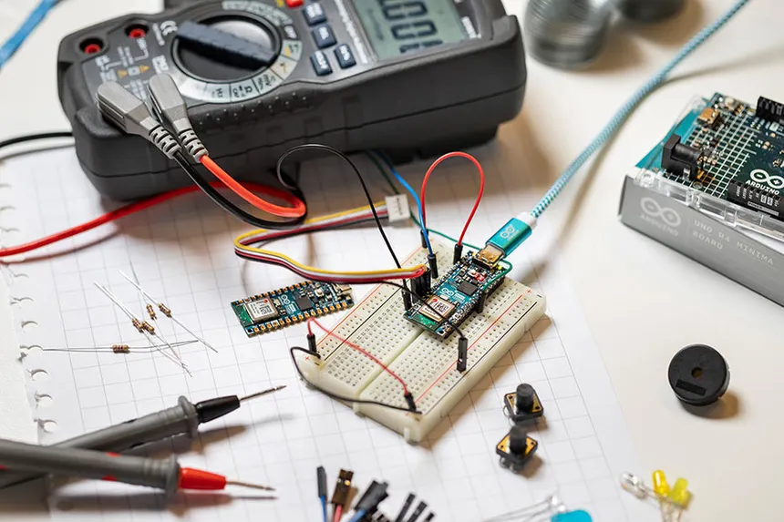
04 / Implementation
Debugging
LED Remains Dark
IDE Reports: Failed to connect to ESP32
Measure voltage across the LED leads; if it reads 1.8-2V but emits no light, the diode is reversed
Hold down the physical BOOT button on the ESP32 during “Connecting…..” compilation phase until writing begins, then release
If the voltage across the LED is 0V, check MCU pin; if it’s toggling, the circuit is open
Serial Monitor Output Unreadable Text or Blank
Verify baud rate
Press the physical EN button the ESP32 board to restart the processor
Dclab/Control System crash Course
>_ terminal gremlin (c-lydia ^_^)
Notes:
DIRECT EDIT VERSION: All visible artwork is on this slide. Click logos, labels, footer text, rules and panels directly. Text uses ordinary text boxes. Use the Selection Pane for small objects; items are named TEXT / LOGO / SHAPE. Duplicate a complete slide to reuse the design. New Slide layouts supply only basic placeholders. Background colour: Format Background / Slide Properties.
Two independent picture placeholders. Use identical crops/scales for comparisons. Suitable for oscilloscope captures, wiring changes or debug output.

Slide 25
>_ KEEP EXPLORING ^_^
References
Making Embedded Systems:
Design Patterns for Great Software
ESP32 Arduino Core Documentation:
LED Control (LEDC)
Elecia White
Espressif Systems
The Art of Electronics:
Student Manual
ESP32 Arduino Core Documentation:
GPIO
Thomas C. Hayes and Paul Horowitz
Espressif Systems
Feedback Systems: An Introduction
for Scientists and Engineers
Arduino Core for the ESP32
Karl Johan Åström and Richard M. Murray
Espressif Systems
Modern Robotics:
Mechanics, Planning, and Control
Motor Drivers Architecture
and Overview
Kevin M. Lynch and Frank C. Park
Texas Instruments
DCLab/Control System Crash Course
>_ terminal gremlin (c-lydia ^_^)
Notes:
References transcribed from Microcontroller (MCU) and Pulse-Width Modulation (PWM).pdf, p. 14. Titles and author names are retained from that source. Full firmware appears on pp. 10–13.

Slide 26
SESSION 01 / MICROCONTROLLER AND PWM
Thank you!
Questions & discussion
CONNECT / CONFIGURE / MEASURE
DCLab/Control System Crash Course
>_ terminal gremlin (c-lydia ^_^)
Notes:
Thank the audience and invite questions. The PWM motif ties the ending to the lesson. Discussion prompt: What changes when duty cycle increases while carrier frequency stays fixed?

